Slide 1
The Reactive Paradigm
An Example: Potential Fields
Lecture 12

Slide 2
Reactive Paradigm: Attributes
All actions are accomplished through behaviors
Behaviors are a direct mapping from sensory inputs to motor outputs that are used to achieve a task (A transfer function)
The planning part of the Sense Plan Act triad is generally absent in Reactive Paradigm. Sensing and Acting are in general tightly coupled. Sensing leads to action through a quick mathematical transform

Slide 3
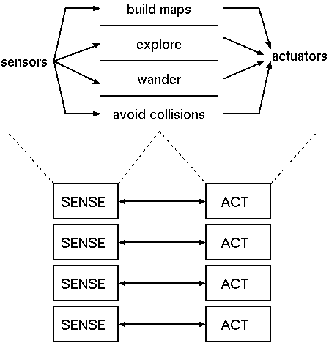
Reactive Paradigm is Vertical
Sensors can be shared and fused by a behavior

Slide 4
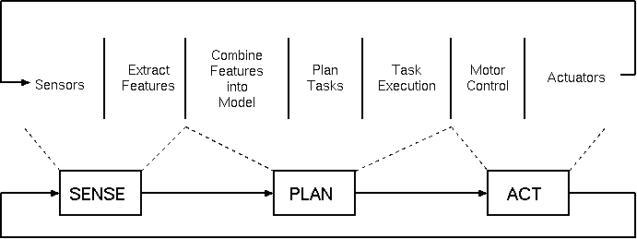
Hierarchical/Planning Paradigm is More Horizontal

Slide 5
Connotations and Characteristics
Executes rapidly. Behaviors can be realized directly in hardware circuits with low complexity
Generally lack memory. Stimulus-response
Robots operate in an open environment subject to change. A-priori map is no more essential for planning or path finding routines.
Behaviors are what that constitute robot actions and overall behavior of the robot is emergent or a combination of basic behaviors. The combination of behaviors is decided by the particular form of architecture that an algorithm uses
Sensing is limited and local to the robot and is from the point of view of robot’s frame of reference

Slide 6
Differences with Hierarchical/Planning Paradigm
HP requires global and exact knowledge of the environment. In RP local and minimal representation of the environment in terms of raw sensory data is sufficient
HP requires planning to be performed before every time an action is executed. The plan is in general with respect to the global information. Reactive paradigm merely reacts to raw sensor information and is distinct from the HP through the lack of planning component

Slide 7

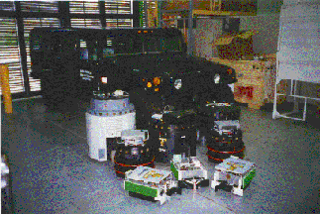
Potential Fields:
Ron Arkin
From http://www.cc.gatech.edu/aimosaic/faculty/arkin
From http://www.cc.gatech.edu/aimosaic/robot-lab/MRLhome.html

Slide 8
The Philosophy
The first principle of a potential fields architecture is that the motor action of a behavior must be represented as a potential field
Perceivable objects in the world exert a force field on the surrounding space
A potential field is an array or field of vectors
From each behavior, the robot “feels” a vector or force
But we visualize the “force” as a field, where every point in space represents the vector that it would feel if it were at that point

Slide 9
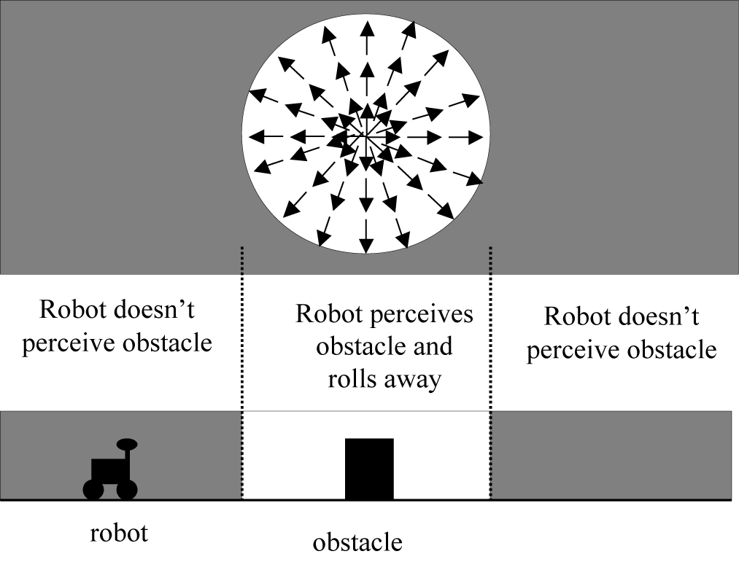
Example: Run Away via Repulsion

Slide 10
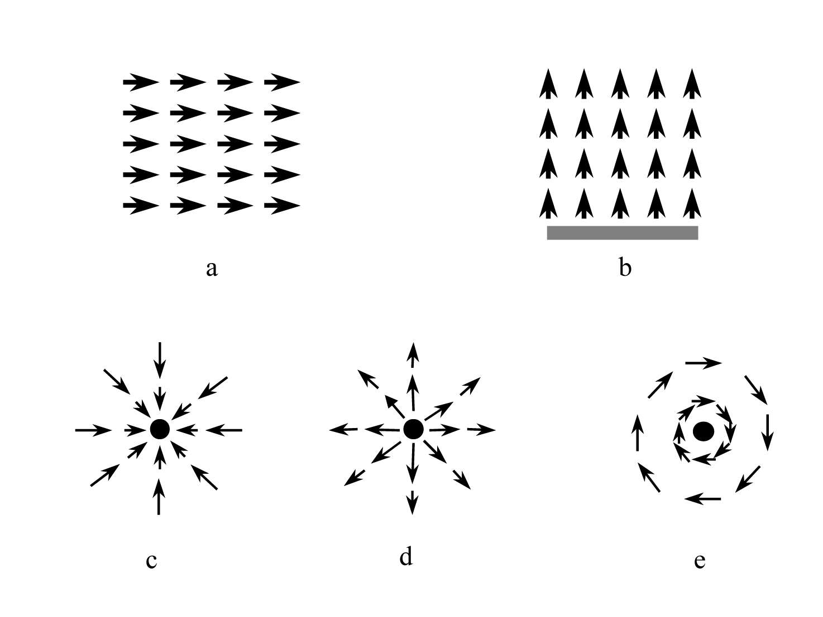
5 Primitive Potential Fields

Slide 11
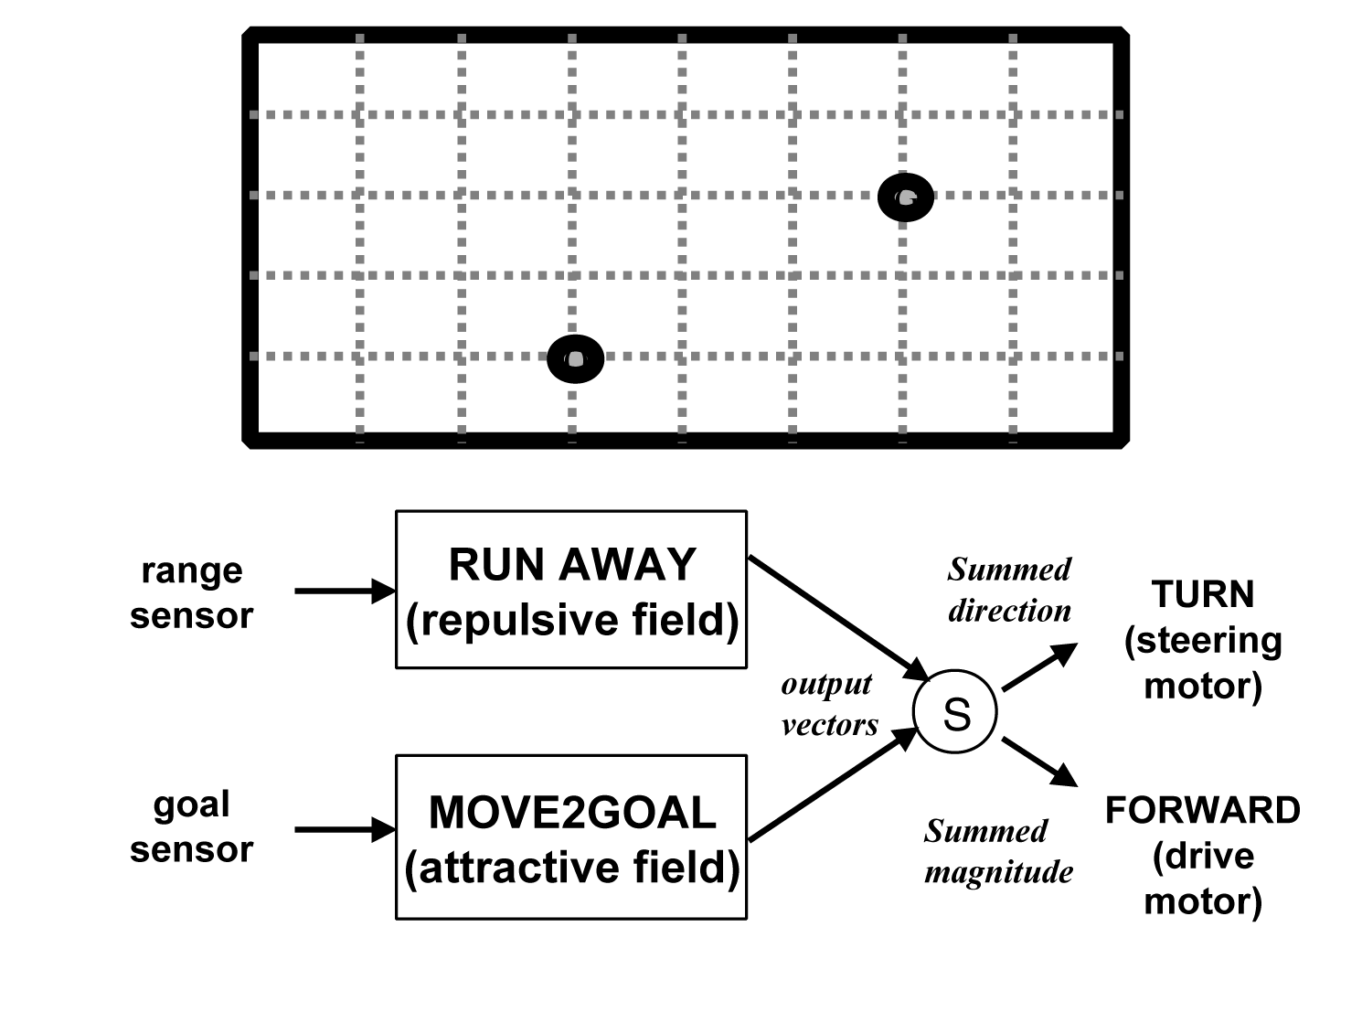
Combining Fields for
Emergent Behavior
goal
goal
obstacle
obstacle
obstacle
If robot were dropped anywhere on this grid,
it would want to move to goal and avoid obstacle:
Behavior 1: MOVE2GOAL
Behavior 2: RUNAWAY
The output of each independent behavior is a vector,
the 2 vectors is summed to produce emergent behavior

Slide 12
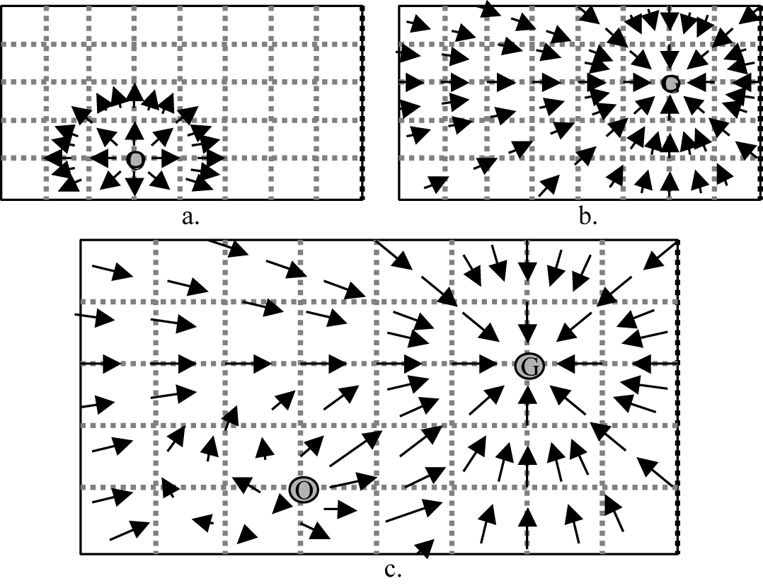
Fields and Their Combination
Note: in this example, robot can sense the
goal from 10 meters away
Note: In this example, repulsive field only extends for 2 meters;
the robot runs away only if obstacle within
2 meters

Slide 13
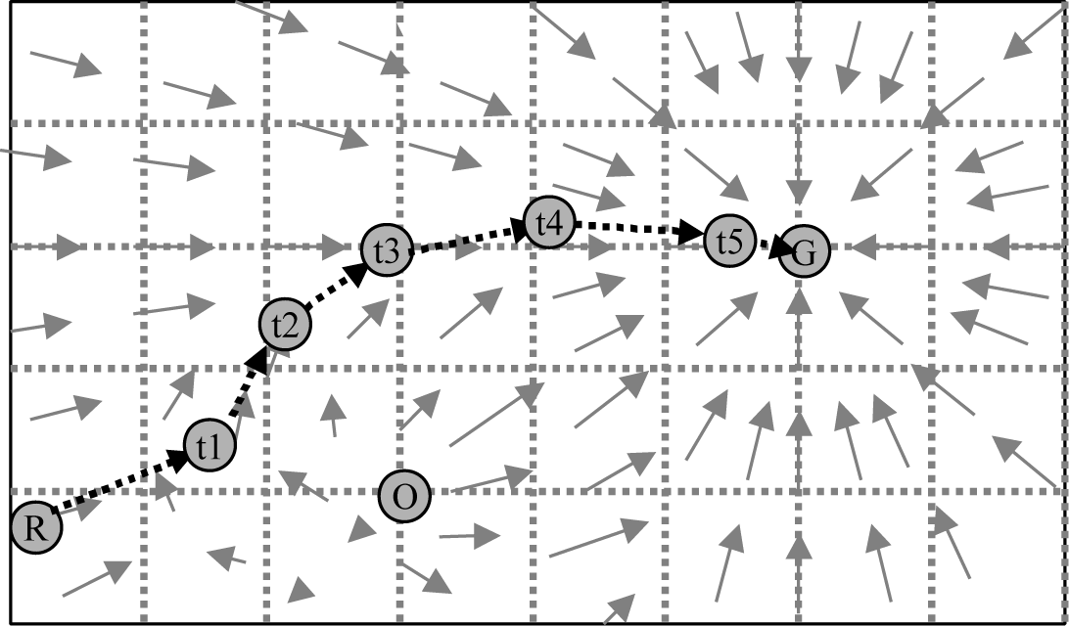
Path Taken
Robot only feels
vectors for this
point when it (if)
reaches that point
If robot started at this location, it would take the following path
It would only “feel”the vector for the location, then move accordingly, “feel” the next vector, move, etc.
Pfield visualization allows us to see the vectors at all points, but robot never computes the “field of vectors” just the local vector

Slide 14
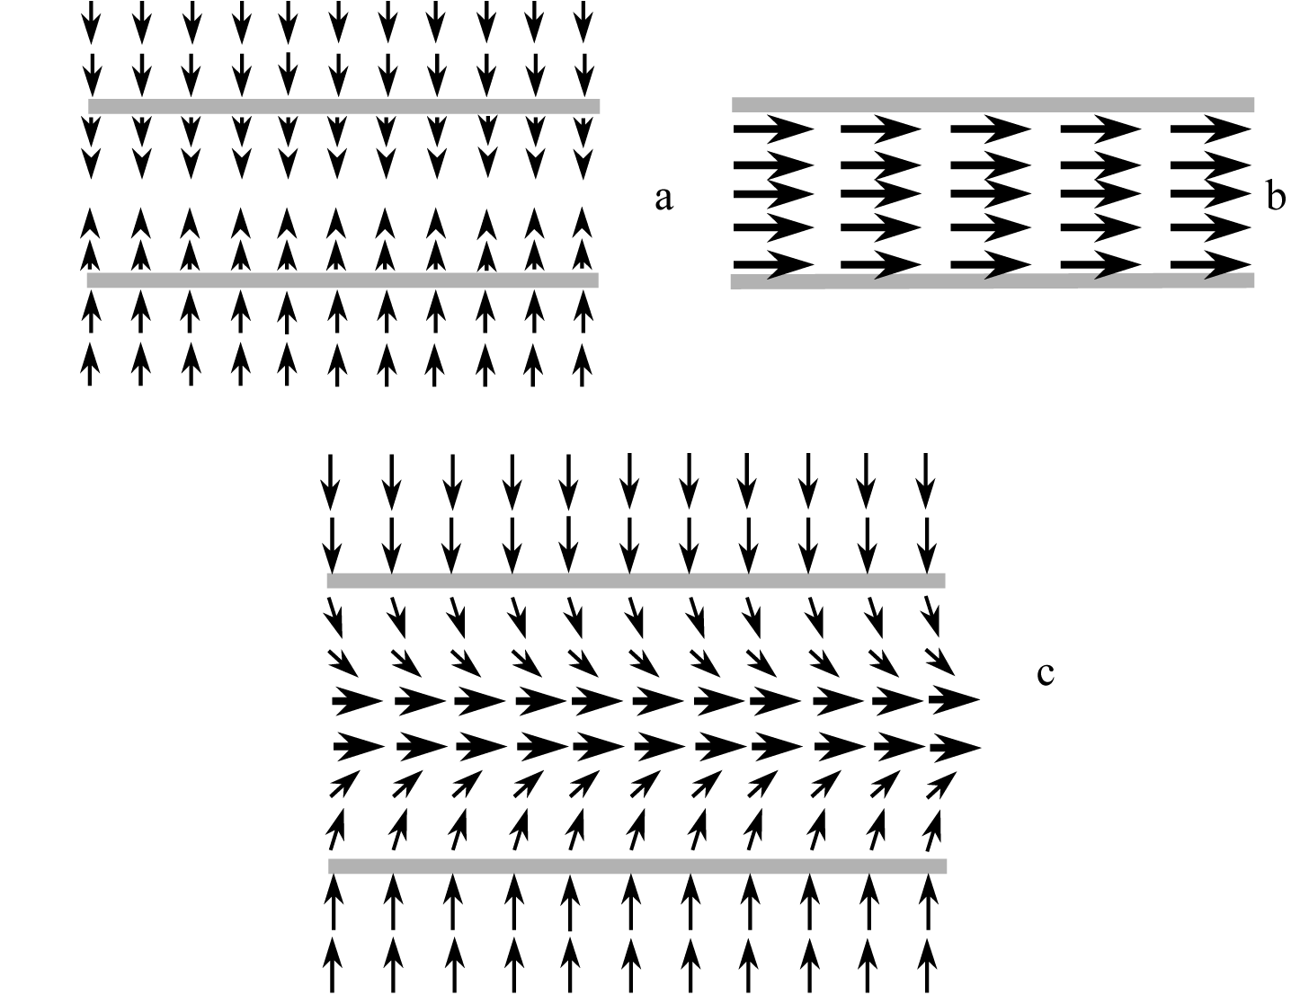
Example: follow-corridor or follow-sidewalk
Perpendicular
Uniform
Note use of
Magnitude profiles:
Perpendicular decreases
Combined

Slide 15
Potential Fields: Evaluation
Advantages
  Easy to visualize
  Easy to build up software libraries
  Fields can be parameterized
  Easy to sum fields through vectorial addition/combination
Disadvantages
  Local minima problem (sum to magnitude=0)
    Box canyon problem
  Jerky motion

